Slide 1

Columbia Asia Hospital
Mudassir Attar

Slide 2

Problem Statement
You have been hired as a consultant data analyst by Columbia Asia Hospital. The Hospital is looking for key insights for the following objectives:
Assess the hospital's revenue generation
Insights about suitable departments for new hires
Strategies suggestions for patient discounts
Your task is to perform data analysis and come up with a report in order to help the organization with the mentioned objectives.

Slide 3

About Columbia Asia Hospital
Founded in 1996, HQ in Kuala Lumpur, Malaysia
Operates 22 hospitals across Malaysia, Vietnam, and Indonesia
Serves middle-income populations with mid-sized hospitals in residential areas
Specialties: Surgery, Cardiology, Neurology, Pediatrics, Orthopedics, Oncology, etc.
Facilities include ICUs, neonatal care, labs, physiotherapy, and pharmacies

Slide 4
Introduction and Objectives
Project Goal: Leverage data analysis to assess Columbia Asia Hospital’s performance and uncover actionable insights to enhance operations, patient satisfaction, and service quality.
Understanding Data: Analyzed a comprehensive dataset covering:
Patient Details: Patient ID, Gender, Age, Race, Initials, and Last Names — to understand patient demographics.
Visit Info: Visit Date & Time, Wait Times, Referred Department, and Doctor — to map the patient journey.
Financial & Quality Metrics: Appointment Fees, Total Bill, Patient Satisfaction Scores, and administrative flags indicating admission status.
Data Preparation
Measure Creation
Various visuals
Interactive Dashboard
Custom measures were built using DAX with calculated columns, filters, aggregations (e.g., SUMX), and time intelligence to enable trend and comparison analysis.
Visual Design Bar charts, cards, gauges, and pie charts—were created to present key metrics and trends clearly
Slicers, drill-throughs, and custom interactions were added to make the dashboard dynamic, allowing users to filter data and gain deeper insights easily
Data was loaded into Power BI and cleaned in Power Query by fixing errors, filling gaps, and ensuring accuracy for reliable analysis

Slide 5

Data snapshot
Total Tables in the Data
Key tables that are either directly referenced or implied in the analysis:
Hospital ER: Contains core patient and visit details, including patient ID, age, gender, race, department referrals, waiting times, and satisfaction scores (patient_sat_score, patient_waittime, patient_age, patient_gender, patient_race, department_referral, Date1, Hours). This is the main table for most analyses.
Doctor Patients: Contains information linking doctors to patients and financial details (Doctor Name, Total Bill, Appointment Fees, patient_id).
Mentioned in the context of data format issues, specifically concerning patient satisfaction scores and date columns.

Slide 6
Data snapshot (Cont…)
Avg. Patient Wait Time: ~35.26 minutes
Dr. Smith's Patients: 5,986
Top Referred Departments: General Practice (7.2K), Orthopedics (1.0K)
Largest Age Group: Seniors (36.3% / 3.35K)
Gender Split: Males (51.05%), Females (48.69%)
Peak Month: August (1,024 visits); Lowest: Feb (431), Nov (464)
Top Revenue Departments: Orthopedics (₹173M), General Practice (₹164M)
Profitability: Steady above 98.9%
Patient Satisfaction: Highest in Middle Age (5.05) & Children (5.02) lowest in Renal
Doctor Satisfaction: Dr. Taylor (5.71 - highest), Dr. Smith (4.99)

Slide 7
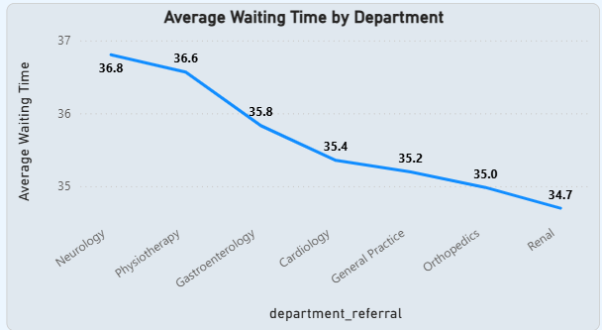
Patient Waiting Time Analysis
Avg. Wait Time: 35.26 mins across hospital
Wait times range: 34.7 – 36.8 mins across departments
Neurology has highest avg wait (36.8 mins), but difference is minimal
No critical delays — indicates efficient and balanced resource allocation

Slide 8
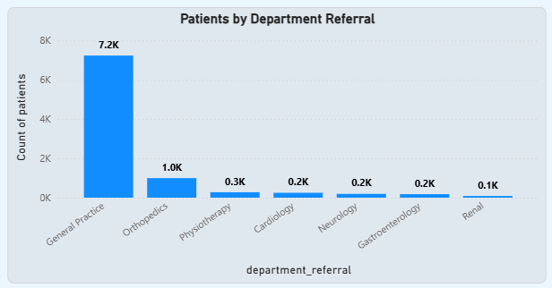
Departmental Visit Trends
General Practice is the busiest with 7,200 visits, serving as the main entry point.
Orthopedics ranks second with only 1,000 visits, showing a clear gap in demand.
Visit patterns help optimize staffing and resource allocation.

Slide 9
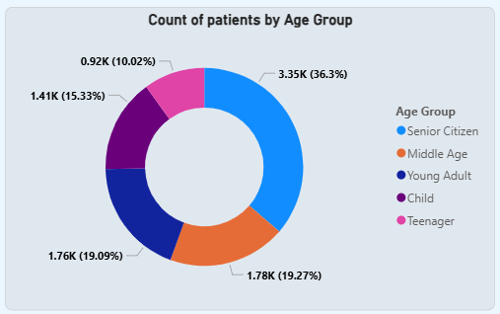
Patient Demographics: Age Group Analysis
Patients segmented into: To better understand who our patients are and how they use our services, categorized them into five distinct age groups. This demographic segmentation helps us tailor our care and services more effectively. 1. Child (0–12) 2. Teenager (12–20) 3. Young Adult (20–35) 4. Middle Age (36–50) 5. Senior Citizen (50+)
Helps design age-specific programs & services Seniors form the largest group — critical for planning eldercare services

Slide 10
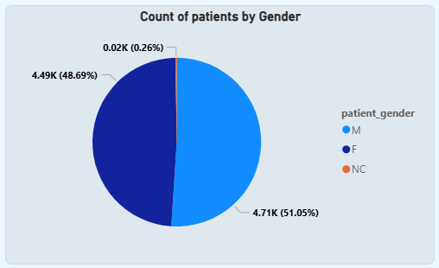
Patient Demographics: Gender Analysis
Balanced gender distribution: Our data indicates that the number of patient visits is almost equally divided between male and female individuals. This suggests that Columbia Asia Hospital provides services that are accessible and utilized broadly across both genders.
Males: 51.05%, Females: 48.69%
'Not Classified' only 0.26% — indicates good data quality

Slide 11
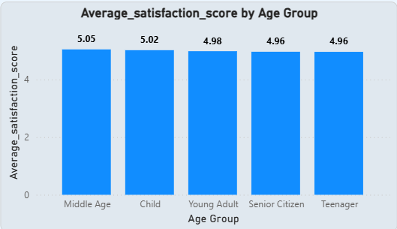
Patient Satisfaction by Demographics
Consistent Satisfaction Across Demographics: Patient satisfaction scores (0–6 scale) are generally high and consistent across racial and age groups, reflecting strong overall care quality.
Teenagers: Slightly lower scores (4.85 – 5.10)
Middle Age: Highest avg satisfaction (5.05)
Seniors & Teenagers: Slightly lower (~4.96) — focus for improvement

Slide 12
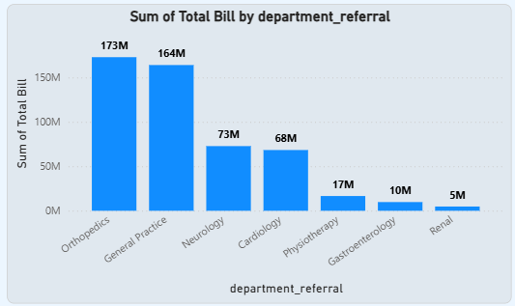
Financial Insights: Departmental Revenue
Financial Performance Overview: Analyzing departmental revenues reveals each unit’s financial impact, helping prioritize profitable areas and inform planning.
Orthopedics Leads: Orthopedics is the top revenue-generating department, indicating strong demand and efficient operations—making it a major contributor to hospital profitability.
Renal Department Needs Attention: In contrast, the Renal department generated the least revenue, suggesting the need to review factors like patient volume, pricing, or service efficiency to identify improvement opportunities.

Slide 13
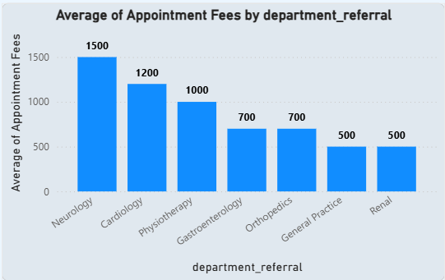
Financial Insights: Appointment Fees
Neurology Commands Premium Fees: The Neurology department charges the highest appointment fees at Columbia Asia Hospital, likely due to its focus on complex cases and advanced diagnostic or treatment services.
Accurate Calculation Using DAX: This insight was derived using a precise DAX formula in Power BI, which calculated the maximum appointment fee by department. This approach ensured accurate and department-specific financial analysis.

Slide 14
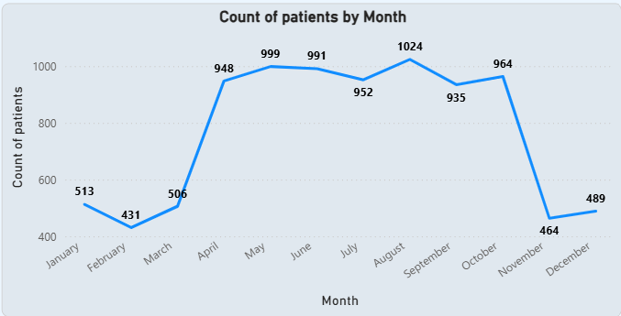
Monthly Patient Visits & Trends
Total Patients visited are 9216
Understanding Seasonal Patient Flow: Analyzing monthly patient visits reveals important seasonal trends that support better staffing and resource planning.
Peak in August: August consistently sees the highest number of visits, indicating a seasonal surge—potentially linked to school holidays, weather changes, or other external factors.
February is the Slowest Month: February records the lowest patient volume, making it a good window for maintenance activities or staff development without affecting operations.
Yearly Patterns: Patient traffic is consistently high from April to October, followed by a sharp drop in November. Volumes remain lower in January–March and November–December, highlighting periods of reduced demand.

Slide 15
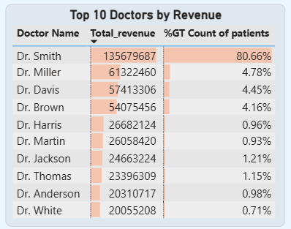
Doctor-Specific Performance: Key Figures
Dr. Smith’s High Patient Volume:
With 5,986 patients, Dr. Smith handles one of the highest patient loads in the hospital. This reflects both strong demand for his services and a potentially heavy workload, suggesting the need for additional support or recognition.
Top Revenue-Generating Doctors:
Analysis identified the top 5 doctors who generated the highest revenue despite treating fewer patients. This highlights efficient, high-value practices, likely involving specialized procedures, and emphasizes their critical role in driving the hospital’s financial performance.

Slide 16

Strategy & Outlook
Targeted Patient Discount Strategies:
Focus on Teenagers: Recommend offering specific discounts to teenagers (aged 12-20). This demographic represents a high-spending group, averaging over ₹59,780.73 in expenses. Discounting can foster long-term patient loyalty and secure future business.
Incentivize High Spenders: Implement attractive discounts for patients whose total bill exceeds ₹10,000. These patients should be categorized as "Eligible" for targeted offers, encouraging repeat visits and strengthening patient retention.
Staffing & Growth
Strategic Doctor Hiring: General Practice Department: With over 7,200 patient visits and only 3 doctors currently managing the load, it is highly recommended to recruit 2–3 additional general practitioners. This expansion will reduce strain on the existing team, enhance service quality, and significantly improve patient access and wait times.
Hospital Profitability Overview: Columbia Asia Hospital displays strong and stable financial performance, with consistently high profitability. This solid financial footing provides the flexibility to invest confidently in staff expansion and patient-centered initiatives, ensuring continued growth and operational excellence.

Slide 17

Dashboard 1

Slide 18
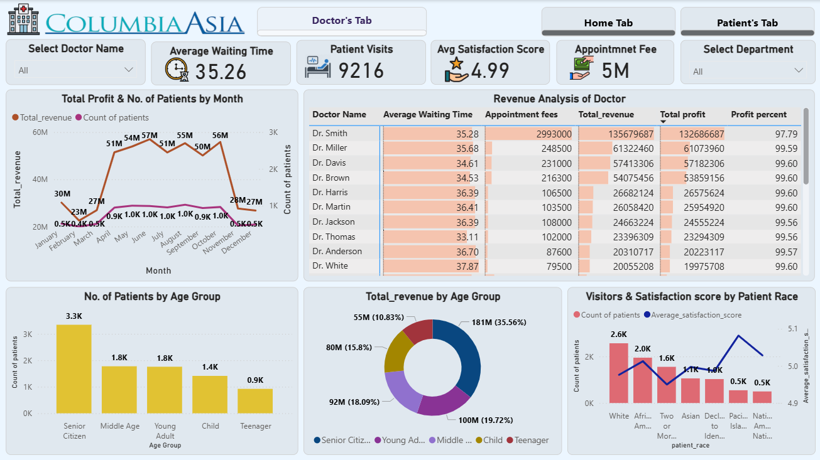
Dashboard 2

Slide 19
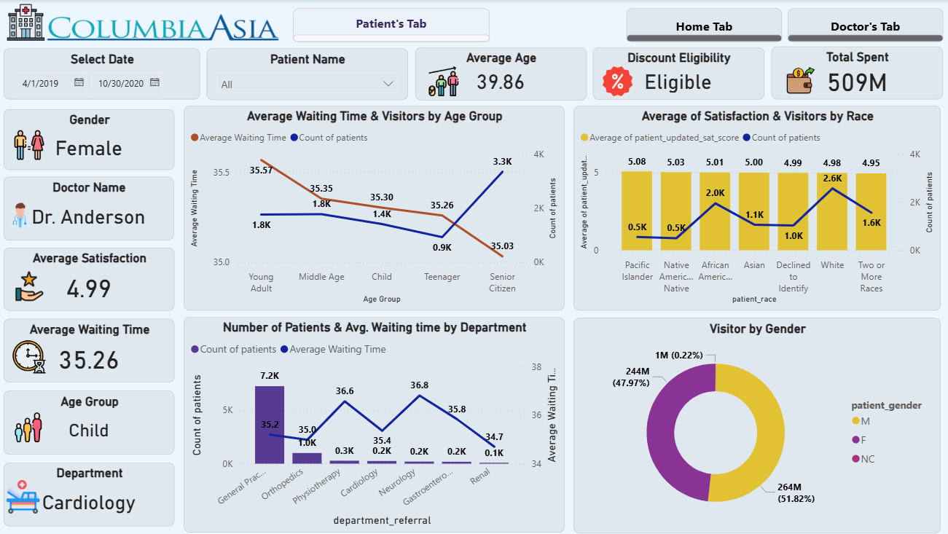
Dashboard 3

Slide 20

Conclusion
Summary of Key Insights: This Power BI project has delivered actionable insights across patient demographics, wait times, departmental efficiency, and financial performance, offering a clear picture of hospital operations.
Driving Informed Decisions: These findings support data-driven decision-making, enabling hospital leadership to improve resource allocation, enhance service quality, and boost patient engagement.
Ongoing Performance Monitoring: Maintaining a practice of regular KPI analysis is crucial for sustained excellence, promoting a culture of continuous improvement, and ensuring consistently high patient satisfaction over time.

Slide 21
Thank you

